Slide 1
WEB 11
React JS

Slide 2
Hooks in React
Hooks are special functions that let you use React features in functional components.
With hooks, you can use:
State (useState)
Lifecycle methods (useEffect)
Other advanced features
Notes:
Lifecycle methods manage side effects and control behavior during a component's lifecycle.
componentDidMount()MountingRuns after the component is added to the DOM. Ideal for initial setup (e.g., API calls).componentDidUpdate()UpdatingRuns after state/props change. Used to respond to updates (e.g., DOM manipulation).componentWillUnmount()UnmountingRuns before the component is removed. Cleanup tasks (e.g., timers, subscriptions).

Slide 3
State in react js
State is like a variable but smarter.
It stores dynamic data and automatically re-renders the component whenever the state changes.
React does not understand normal JavaScript variables for UI updates.
If you want to update and reflect values in the UI, use state.
Key Characteristics of State:
Component-Specific State is local to its component and not accessible to other components unless explicitly passed via props.
Mutable Unlike props (which are read-only), state can be updated using dedicated methods like setState (class components) or state-setting functions from hooks like useState (functional components).
Triggers Re-renders Changing state causes React to re-render the component and update the DOM to reflect new values.

Slide 4
Click Event and Function Call
function Fruits() {
const fruits = (name) => {
alert(name);
};
return (
<div>
<button onClick={() => fruits("Apple")}>Apple</button>
<button onClick={() => fruits("Banana")}>Banana</button>
</div>
); }
export default Fruits;

Slide 5
How to use State
import { useState } from "react";
function App() {
const [fruit, setFruit] = useState("Apple");
const handleFruit = () => {
setFruit("Banana");
};
return (
<div>
<h1>State in React JS</h1>
<h2>{fruit}</h2>
<button onClick={handleFruit}>Change Fruit Name</button>
</div>
);
}
Apple
onclick
Banana
Notes:
Console.log(fruit);

Slide 6
How to use State
import React, { useState } from "react";
const Counter = () => {
const [counter, setCounter] = useState(0);
const [rCounter, setRCounter] = useState(10);
return (
<div>
<h1>Counter: {counter}</h1>
<h1>R Counter: {rCounter}</h1>
<button onClick={() => setCounter(counter + 1)}>Update Counter</button>
<button onClick={() => setRCounter(rCounter - 1)}>Update R Counter</button>
</div>
);
};
export default Counter;

Slide 7
Example State
import { useState } from "react";
function App() {
const [display, setDisplay] = useState(true);
return (
<div>
<h1>Toggle in React JS</h1>
<button onClick={() => setDisplay(!display)}>Toggle</button>
{display ? <h1>Door</h1> : null}
</div>
);
} export default App;
Notes:
If else display ? <h1>Furqan</h1> : null <h1>No User</h1>
setDisplay(!display)}> if true then false false then true
User display ? <h1>Furqan

Slide 8
Example State
import { useState } from "react";
import User from "./User";
function App() {
const [display, setDisplay] = useState(true);
return (
<div>
<h1>Toggle in React JS</h1>
<button onClick={() => setDisplay(!display)}>Toggle</button>
{display ? <User /> : null}
</div>
);
}
export default App;
function User() {
return (
<div>
<h1>User Component</h1>
</div>
);
}
export default User;

Slide 9
Example State
import { useState } from "react";
function App() {
const [count, setCount] = useState(0);
return (
<div>
<h1>{count}</h1>
<button onClick={() => setCount(count + 1)}>Counter</button> {
count === 0 ? <h1>Condition 0</h1>
: count === 1 ? <h1>Condition 1</h1>
: count === 2 ? <h1>Condition 2</h1>
: count === 3 ? <h1>Condition 3</h1>
: count === 4 ? <h1>Condition 4</h1>
: <h1>Other Condition</h1>
}
</div> );
} export default App;

Slide 10
Changing Background Color
import { useState } from 'react';
export default function LightSwitch() {
const [isDark, setIsDark] = useState(false);
function handleClick() {
setIsDark(!isDark);
}
// Update background using React-controlled state
document.body.style.backgroundColor = isDark ? 'black' : 'white';
return (
<button onClick={handleClick}>
Toggle the lights
</button>
);
}

Slide 11
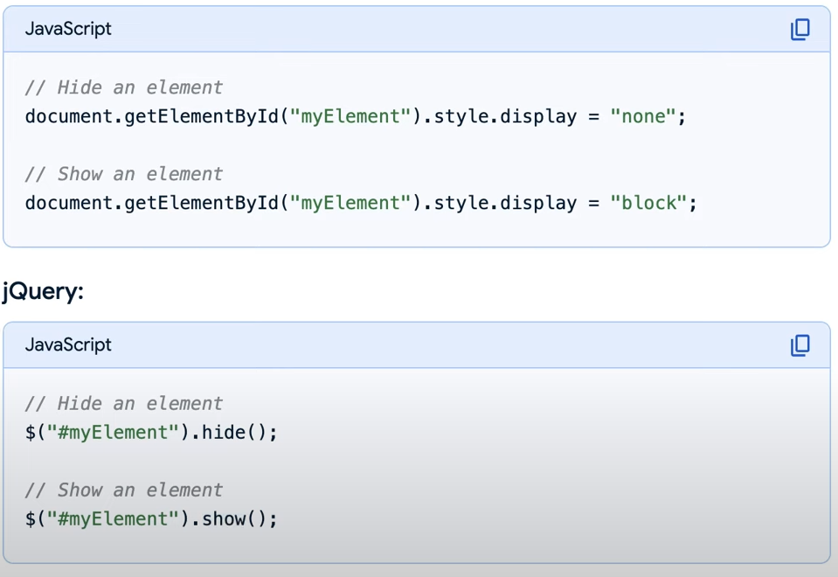
Toggle JavaScript and JQuery

Slide 12
Toggle by Using useState React
import { useState } from "react";
function Toggle() {
const [display, setDisplay] = useState(true);
return (
<div>
<h1>Toggle in React JS</h1>
<button onClick={() => setDisplay(!display)}>Toggle</button>
{display ? <h1>Web Engineering</h1> : null}
</div>
);
}
export default Toggle;

Slide 13
Toggle by using useState Home Work
function Profile() {
return (
<div>
<h1>Profile Info</h1>
</div>
);
}
export default Profile;
import { useState } from "react";
import User from "./User";
function App() {
const [display, setDisplay] = useState(true);
return (
<div>
<h1>Toggle in React JS</h1>
<button onClick={() => setDisplay(!display)}>Toggle</button>
{display ? <User /> : null}
</div>
);
}
export default App;

